Slide 1
Room
Persistence library

Slide 2
Room
Topics Covered
Overview of Room
Why room
Components of Room
Room Database
Dao
Entity

Slide 3
Room
The Room persistence library provides an abstraction layer over SQLite to allow fluent database access while harnessing the full power of SQLite.
Use Case: to cache relevant pieces of data so that when the device cannot access the network, the user can still browse that content while they are offline.
In general, we use Room database by using MVVM architecture. The high-level structure is shown in next slide.

Slide 4
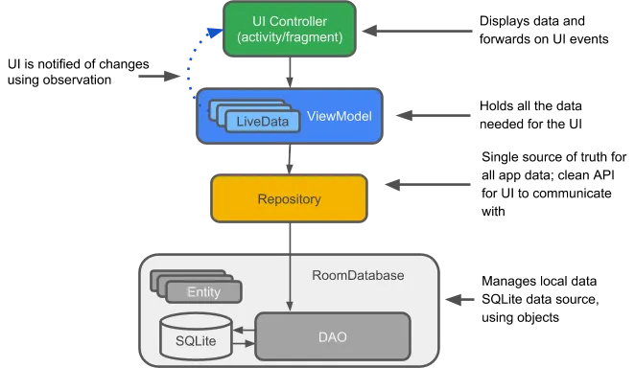
Cont’d

Slide 5
Benefits of Room
In particular, Room provides the following benefits:
Compile-time verification of SQL queries.
Convenience annotations that minimize repetitive and error-prone boilerplate code
Streamlined database migration paths.

Slide 6
Components of Room
There are three major components in Room:
The database class that holds the database and serves as the main access point for the underlying connection to your app's persisted data.
Data entities that represent tables in your app's database.
Data access objects (DAOs) that provide methods that your app can use to query, update, insert, and delete data in the database.

Slide 7
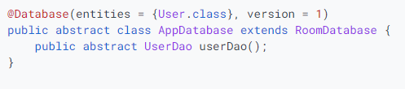
Database CLASS
provides your app with instances of the DAOs associated with that database. In turn, the app can use the DAOs to retrieve data from the database as instances of the associated data entity objects.
Sample Room Database class

Slide 8
Cont’d [DATABASE CLASS]
The previous screenshot defines the AppDatabase to hold the database. it defines the database configuration and serves as the app's main access point to the persisted data. The database class must satisfy the following conditions:
The class must be annotated with a @Database annotation that includes an entities array that lists all of the data entities associated with the database.
The class must be an abstract class that extends RoomDatabase.
For each DAO class that is associated with the database, the database class must define an abstract method that has zero arguments and returns an instance of the DAO class.
N.B : If your app runs in a single process, you should follow the singleton design pattern when instantiating an AppDatabase object. Each RoomDatabase instance is fairly expensive, and you rarely need access to multiple instances within a single process.

Slide 9
DaO
This contains methods to perform the operations on the database. And annotated with “@Dao”.
Each DAO includes methods that offer abstract access to your app's database. At compile time, Room automatically generates implementations of the DAOs that you define.
The following code defines a DAO called UserDao. UserDao provides the methods that the rest of the app uses to interact with data in the user table.

Slide 10
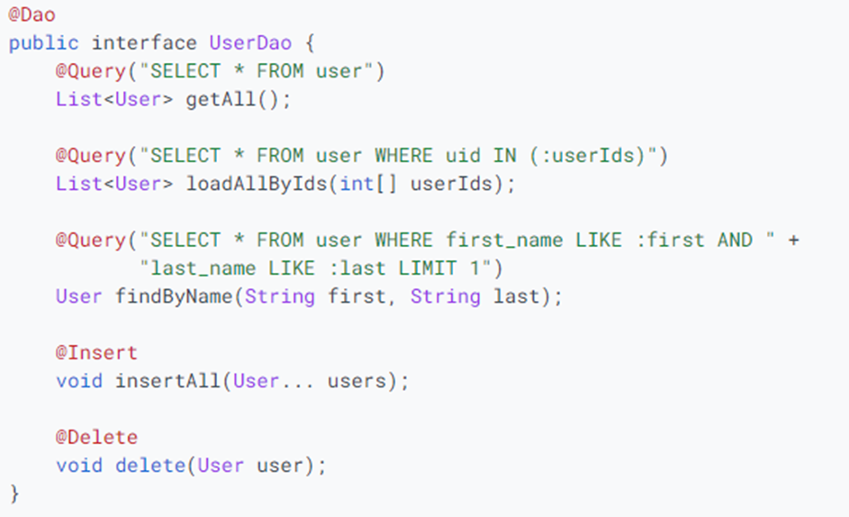
DAO (Cont’d)

Slide 11
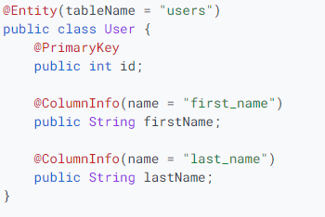
ENTITY
A table in the database is represented by an entity.
A Room entity includes fields for each column in the corresponding table in the database, including one or more columns that make up the primary key.
To persist a field, Room must have access to it. You can make sure Room has access to a field either by making it public or by providing getter and setter methods for it.
The following code defines a User data entity. Each instance of
User represents a row in a user table in the app's database.

Slide 12
ENTITY(Cont’d)
By default, Room uses the class name as the database table name.
If there is a need to change the table to have a different name, set the tableName property of the @Entity annotation. Similarly, Room uses the field names as column names in the database by default. If you want a column to have a different name, add the @ColumnInfo annotation to the field and set the name property.
Table and column names in SQLite are case-insensitive.

Slide 13
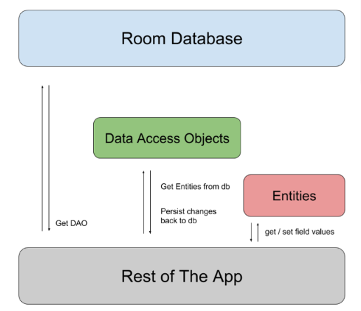
Summary

